Slide 1
Directions
N-s-e-w

Slide 2
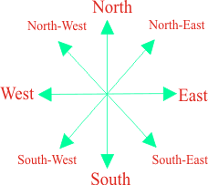

Slide 4
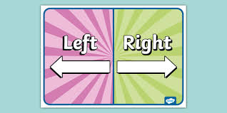
Demonstration of Left turn and right turn
Facing North Facing South

Slide 5
Demonstration of Left turn and right turn
Facing East Facing West

Slide 6
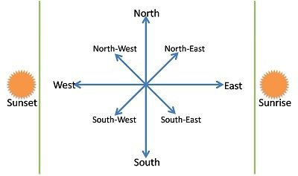
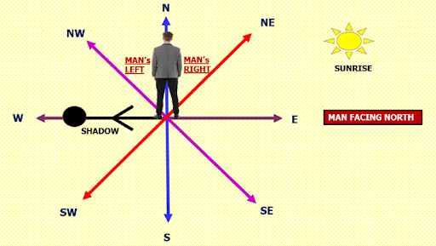
Sunset and Sunrise

Slide 7
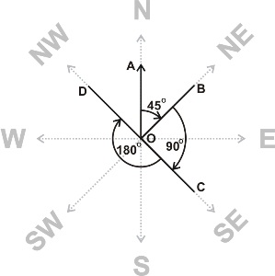
Clock Based

Slide 8
Model 1:
A man walks 5 km toward south and then turns to the right. After walking 3 km he turns to the left and walks 5 km. Now in which direction is he from the starting place?

Slide 9
2. Rasik walked 20 m towards north. Then he turned right and walks 30 m. Then he turns right and walks 35 m. Then he turns left and walks 15 m. Finally he turns left and walks 15 m. In which direction and how many metres is he from the starting position?

Slide 10
3. A boy rode his bicycle Northward, then turned left and rode 1 km and again turned left and rode 2 km. He found himself 1 km west of his starting point. How far did he ride northward initially?

Slide 11
Model 2:
If South-East becomes North, North-East becomes West and so on. What will West become?

Slide 12
2. Y is in the East of X which is in the North of Z. If P is in the South of Z, then in which direction of Y, is P?

Slide 13
3. K is 40 m South-West of L. If M is 40 m South-East of L, then M is in which direction of K?

Slide 14
4. Some boys are sitting in three rows all facing North such that A is in the middle row. P is just to the right of A but in the same row. Q is just behind of P while R is in the North of A. In which direction of R is Q?

Slide 15
Model 3:
One morning Udai and Vishal were talking to each other face to face at a crossing. If Vishal's shadow was exactly to the left of Udai, which direction was Udai facing?

Slide 16
2. One evening before sunset Rekha and Hema were talking to each other face to face. If Hema's shadow was exactly to the right of Hema, which direction was Rekha facing?

Slide 17
3. One morning sujata started to walk towards the Sun. After covering some distance she turned to right then again to the right and after covering some distance she again turns to the right. Now in which direction is she facing?

Slide 18
4. One morning after sunrise, Vimal started to walk. During this walking he met Stephen who was coming from opposite direction. Vimal watch that the shadow of Stephen to the right of him (Vimal). To Which direction Vimal was facing?

Slide 19
Model 4:
Rahul put his timepiece on the table in such a way that at 6 P.M. hour hand points to North. In which direction the minute hand will point at 9.15 P.M. ?

Slide 20
2. If A x B means A is to the south of B; A + B means A is to the north of B; A % B means A is to the east of B; A - B means A is to the west of B; then in P % Q + R - S, S is in which direction with respect to Q?

Slide 21
3. Shyam walks 5 km towards East and then turns left and walks 6 km. Again he turns right and walks 9 km. Finally he turns to his right and walks 6 km. How far is he from the starting point?

